Slide 1
Listening and integrated skills A2
Instructor: Nguyen Ha Phuong

Slide 2
Unit 5: Food on the move
Pages 81-100

Slide 3
Lesson objectives
By the end of the lesson, students will be able to:
Discuss food habits and health.
Respond to a listening about how we taste foods.
Respond to a listening about “ugly” food.
Use compound words.
Recognize a speaker’s point of view.
Listen for reasons.
Use a t-chart for note taking.

Slide 4
TABLE OF CONTENTS
01
02
03
04
05
VOCABULARY A
LISTENING A
VIDEO WATCHING
VOCABULARY B
LISTENING B

Slide 5
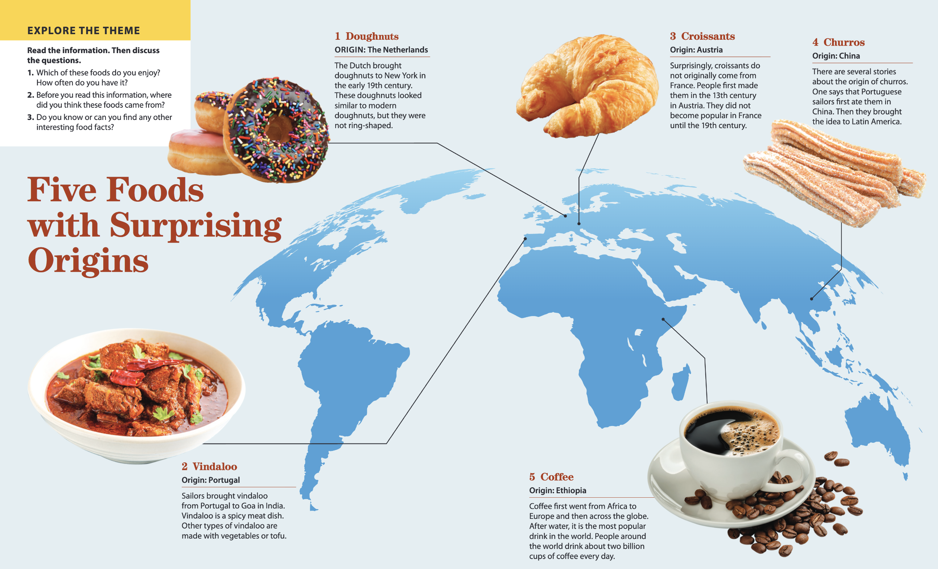

Slide 6

01
Vocabulary A

Slide 7

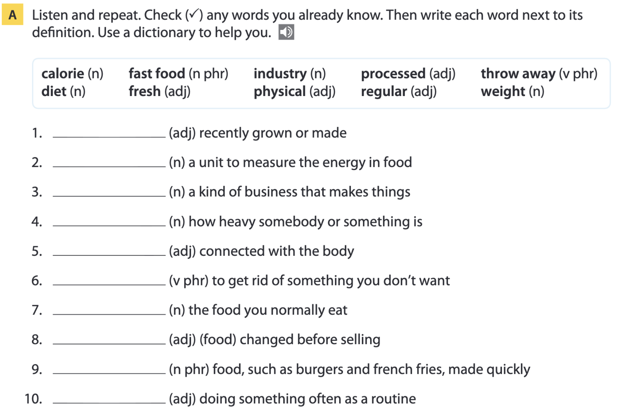
Page 84
fresh
calorie
industry
weight
physical
throw away
diet
processed
fast food
regular

Slide 8
Word list
fresh /freʃ/ (adj): tươi, mới
calorie /ˈkæləri/ (n): calo
industry /ˈɪndəstri/ (n): ngành công nghiệp
weight /weɪt/ (n): cân nặng, trọng lượng
physical /ˈfɪzɪkl/ (adj): thuộc về thể chất, cơ thể
throw away /ˈθrəʊ əweɪ/ (phr. v): vứt bỏ
diet /ˈdaɪət/ (n): chế độ ăn uống
processed /ˈprəʊsest/ (adj): đã qua chế biến
fast food /ˌfɑːst ˈfuːd/ (n phr): thức ăn nhanh
regular /ˈreɡjələ(r)/ (adj): thường xuyên

Slide 9
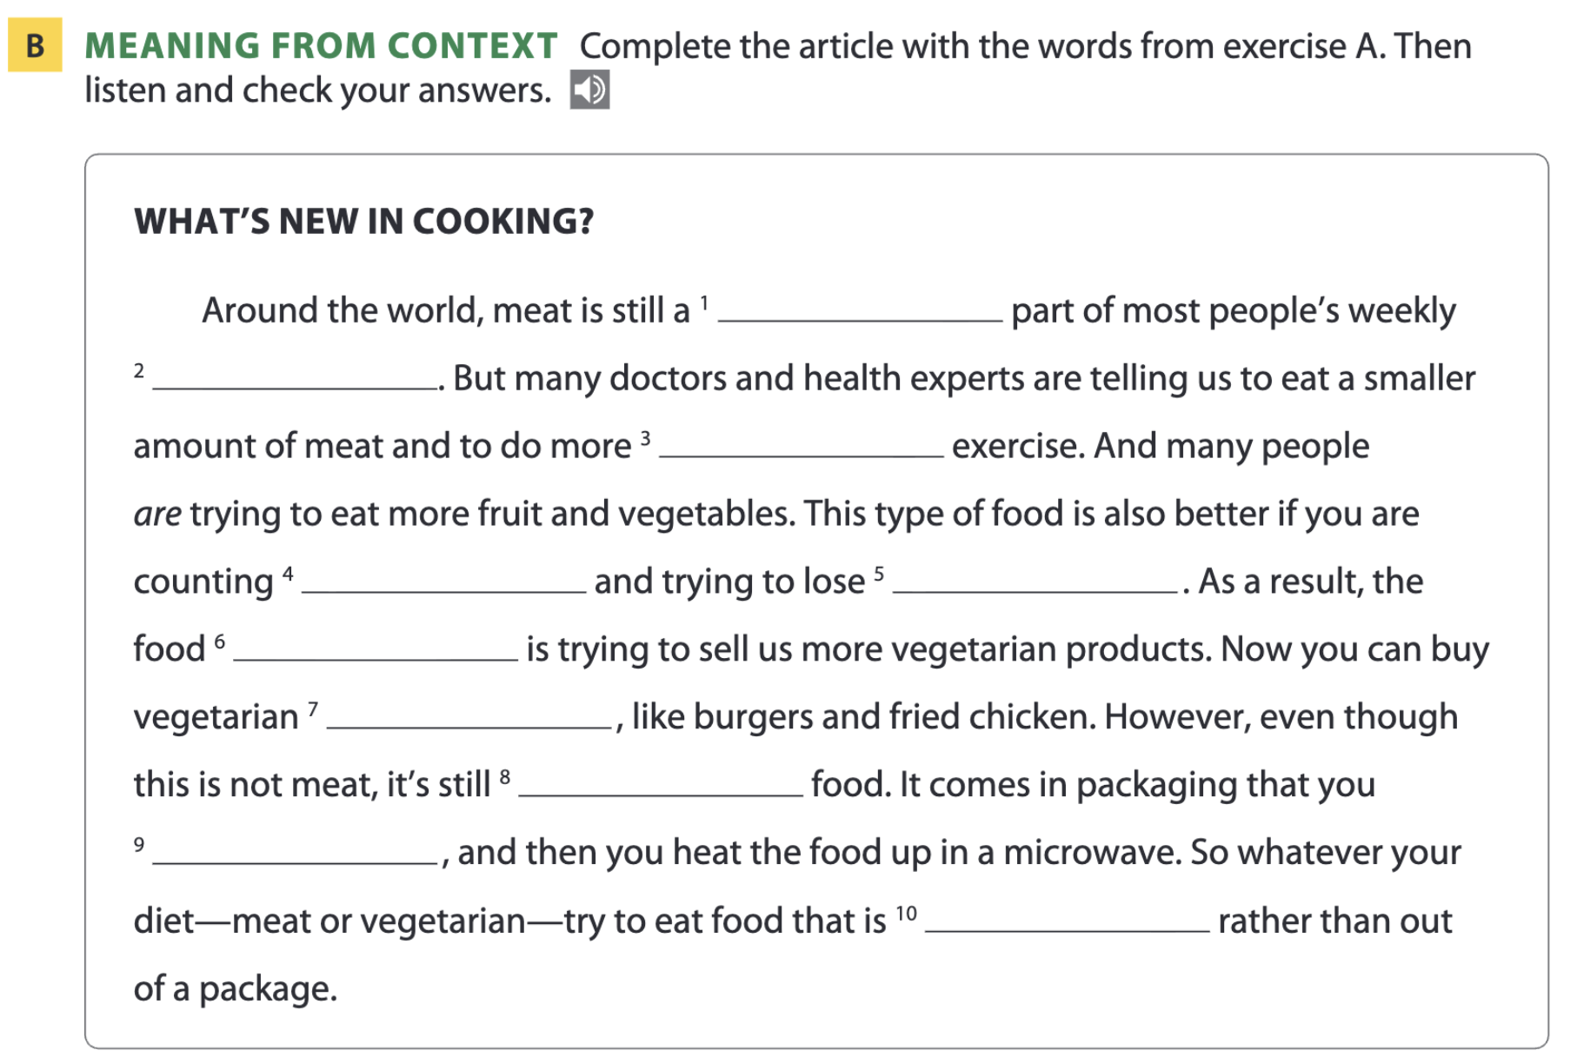
Page 84
regular
diet
physical
calories
weight
industry
fast food
processed
throw away
fresh

Slide 10
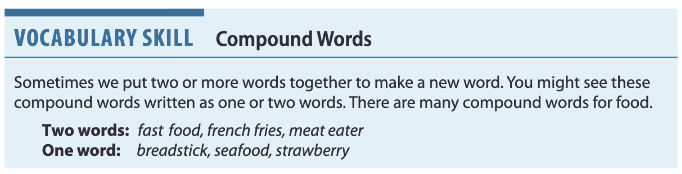
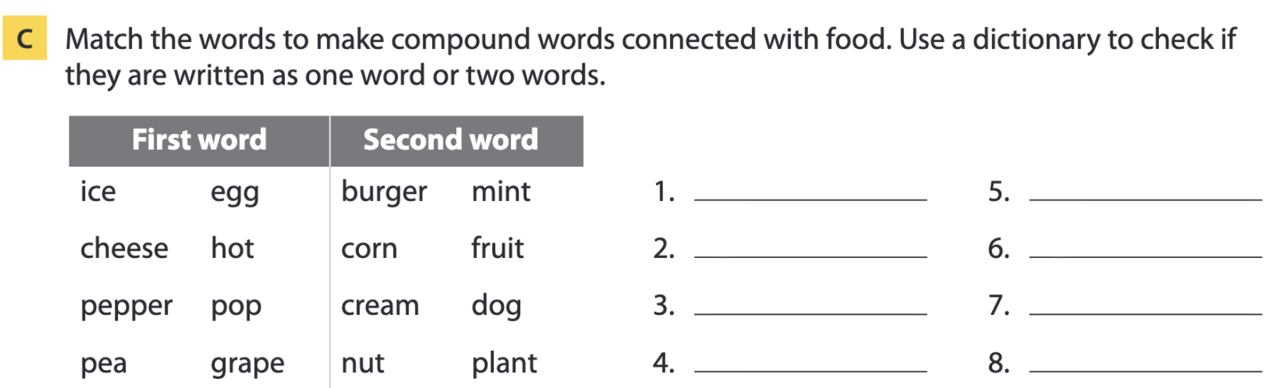
Page 85
Note: The first part of a compound word is generally stressed more than the second.
ice cream
cheeseburger
peppermint
peanut
eggplant
hot dog
popcorn
grapefruit

Slide 11

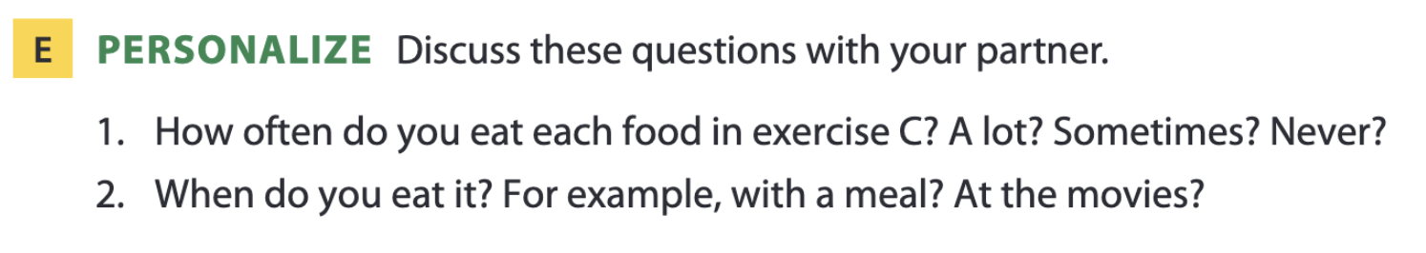
Page 85

Slide 12

02
Listening A

Slide 13
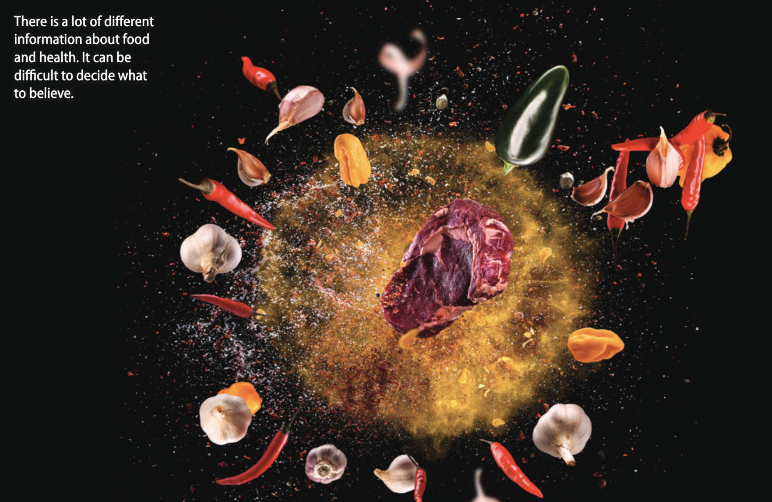
Read the caption.
Do you agree?

Slide 14
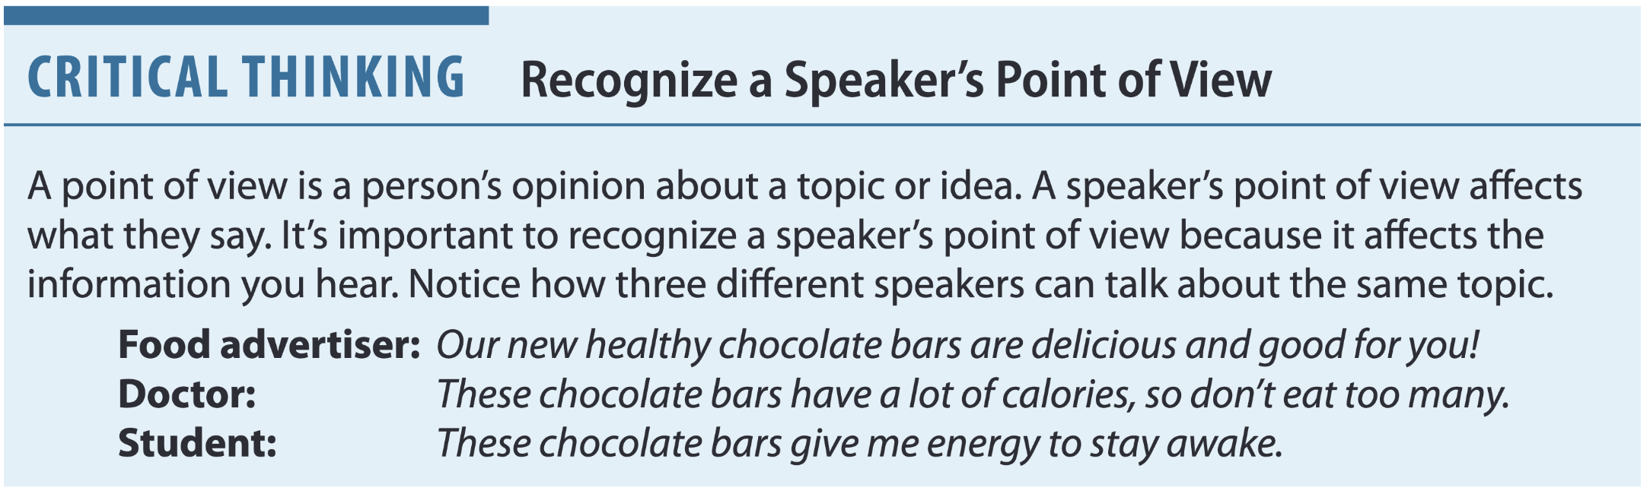
Food fact or fiction?
Page 86

Slide 15
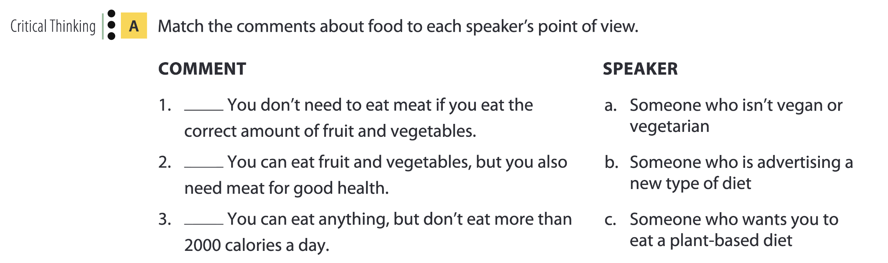
Page 86
c
a
b

Slide 16
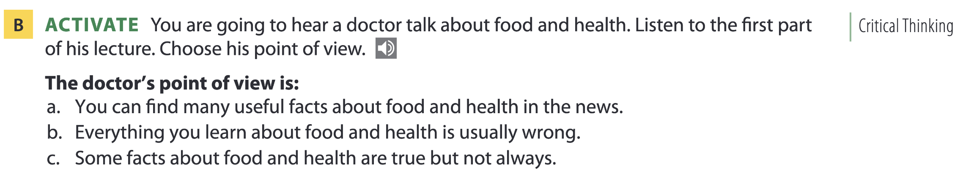
Page 87

Slide 17
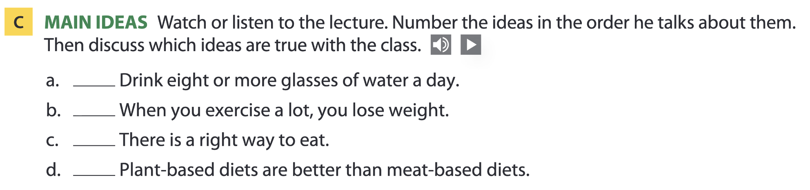
Page 87
1
3
4
2
None of the ideas is completely true.

Slide 18
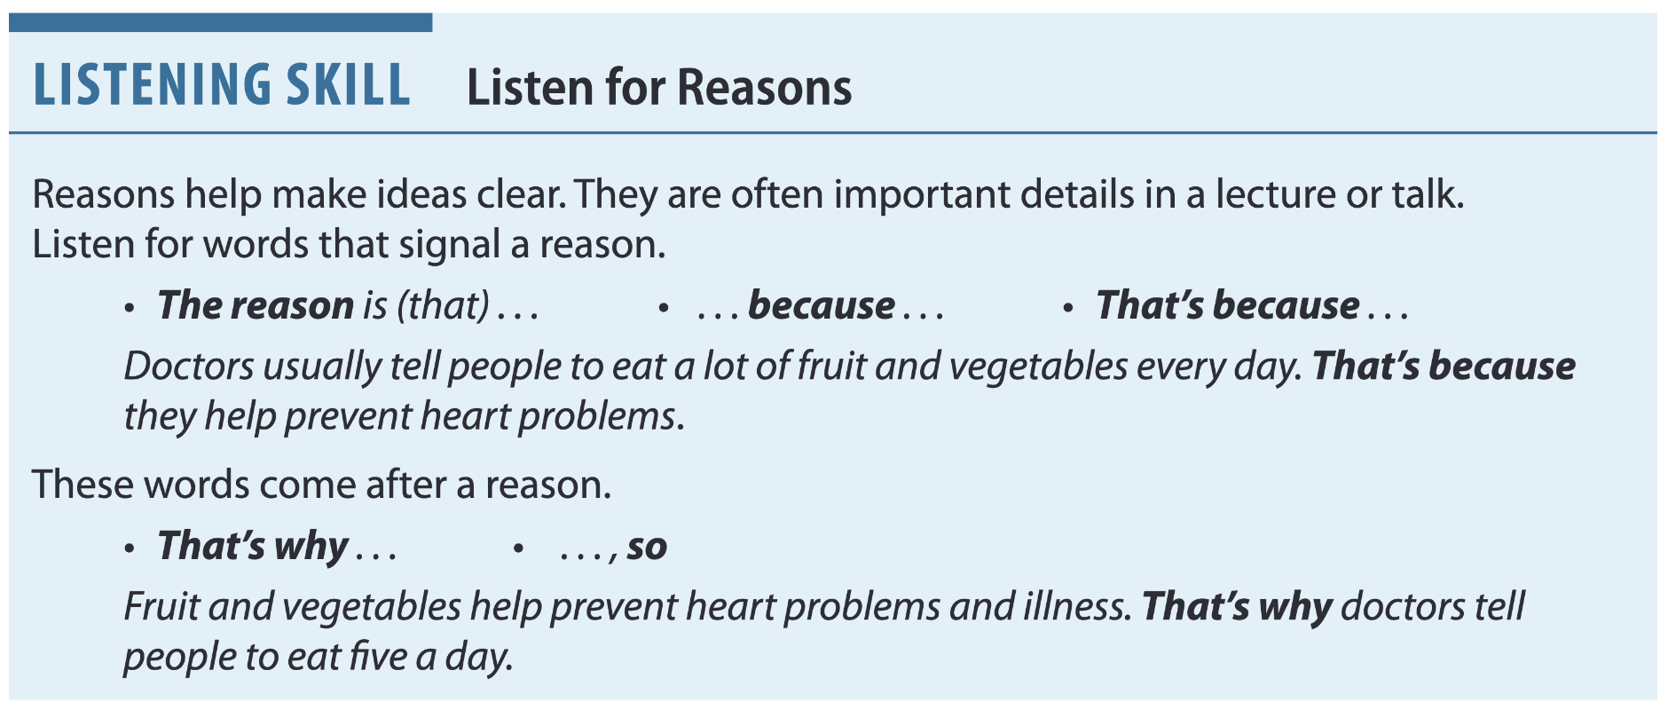
Page 87

Slide 19
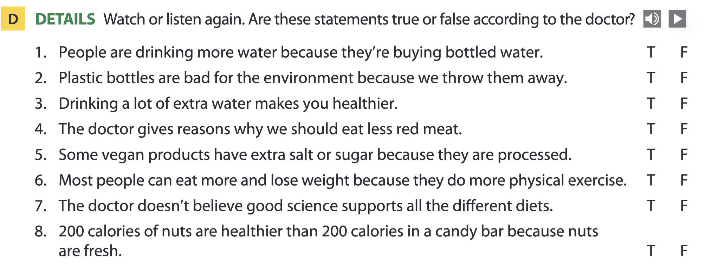
Page 87

Slide 20
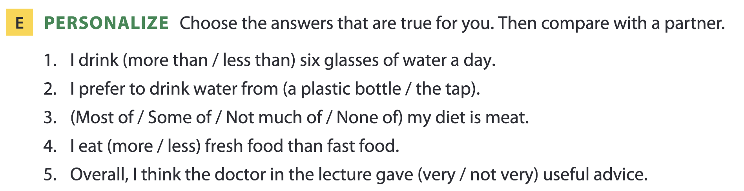
Page 87

Slide 21

03
Video watching

Slide 22
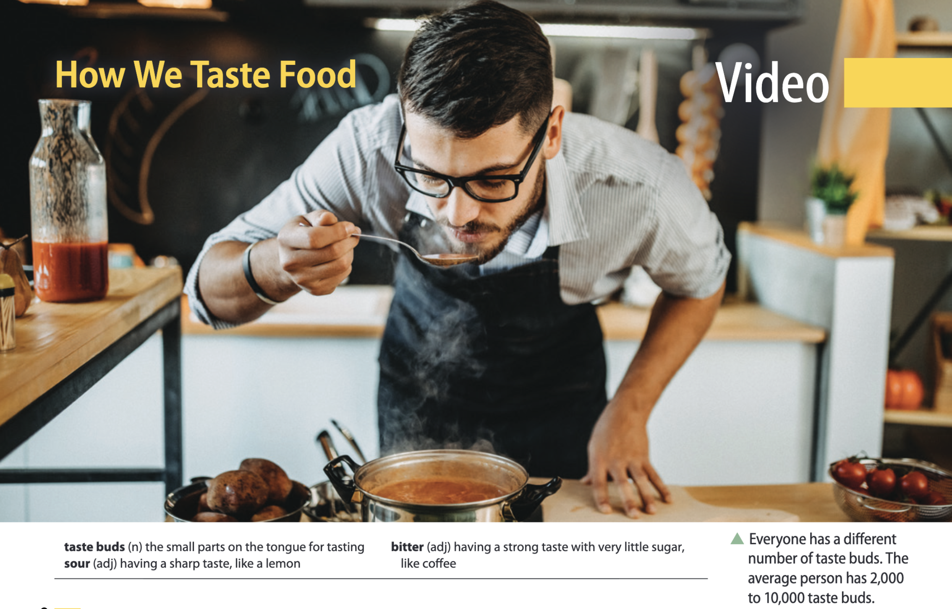
Page 91

Slide 23
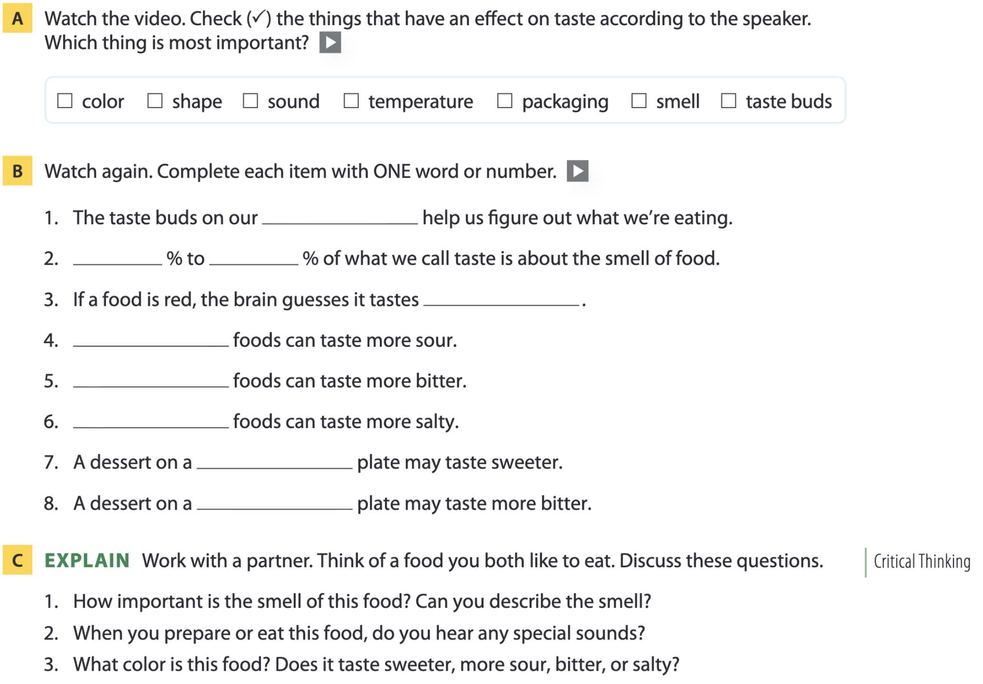

Page 91
tongue
75. 95
sweet
Green
Black
White
round
square

Slide 24
04
Vocabulary B

Slide 25
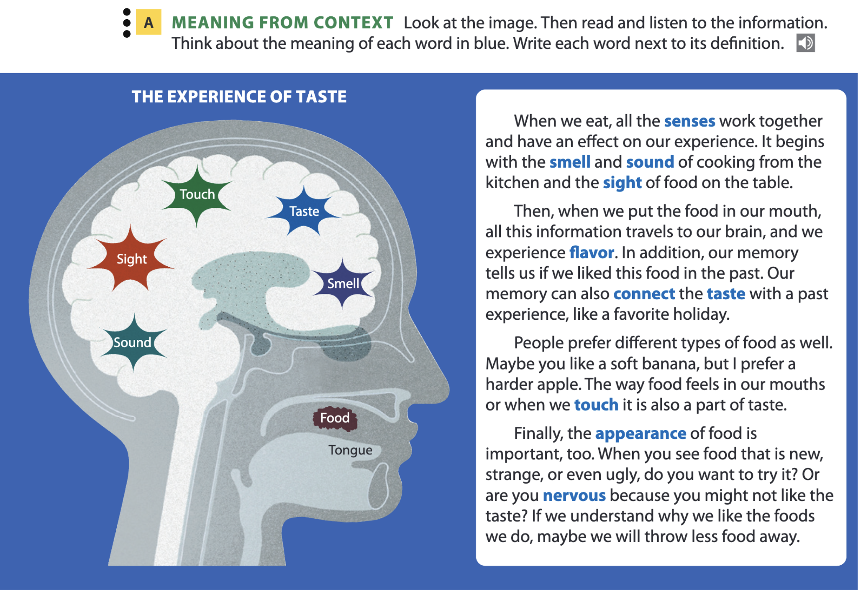
Page 92

Slide 26
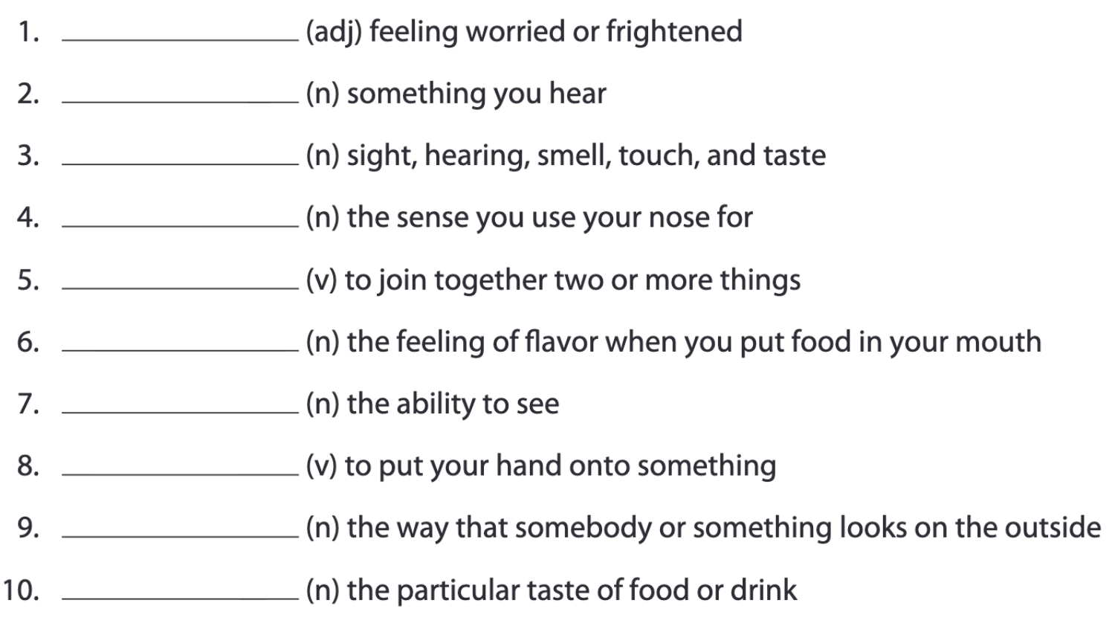
Page 92
nervous
sound
senses
smell
connect
taste
sight
touch
appearance
flavor

Slide 27
Word list
nervous /ˈnɜːvəs/ (adj): lo lắng, hồi hộp
sound /saʊnd/ (n): âm thanh
senses /ˈsensɪz/ (n): các giác quan
smell /smel/ (n): khứu giác, mùi
connect /kəˈnekt/ (v): kết nối, nối liền
taste /teɪst/ (n): vị giác, mùi vị
sight /saɪt/ (n): thị giác, tầm nhìn
touch /tʌtʃ/ (v): chạm, sờ
appearance /əˈpɪərəns/ (n): vẻ bề ngoài
flavor /ˈfleɪvə(r)/ (n): hương vị

Slide 28
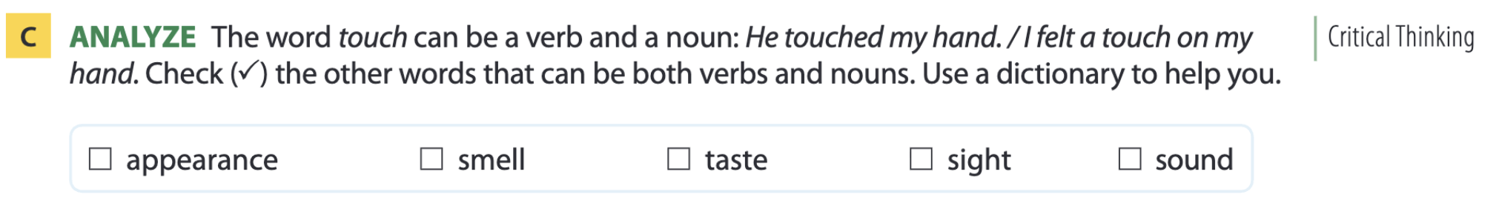
Page 93

Slide 29
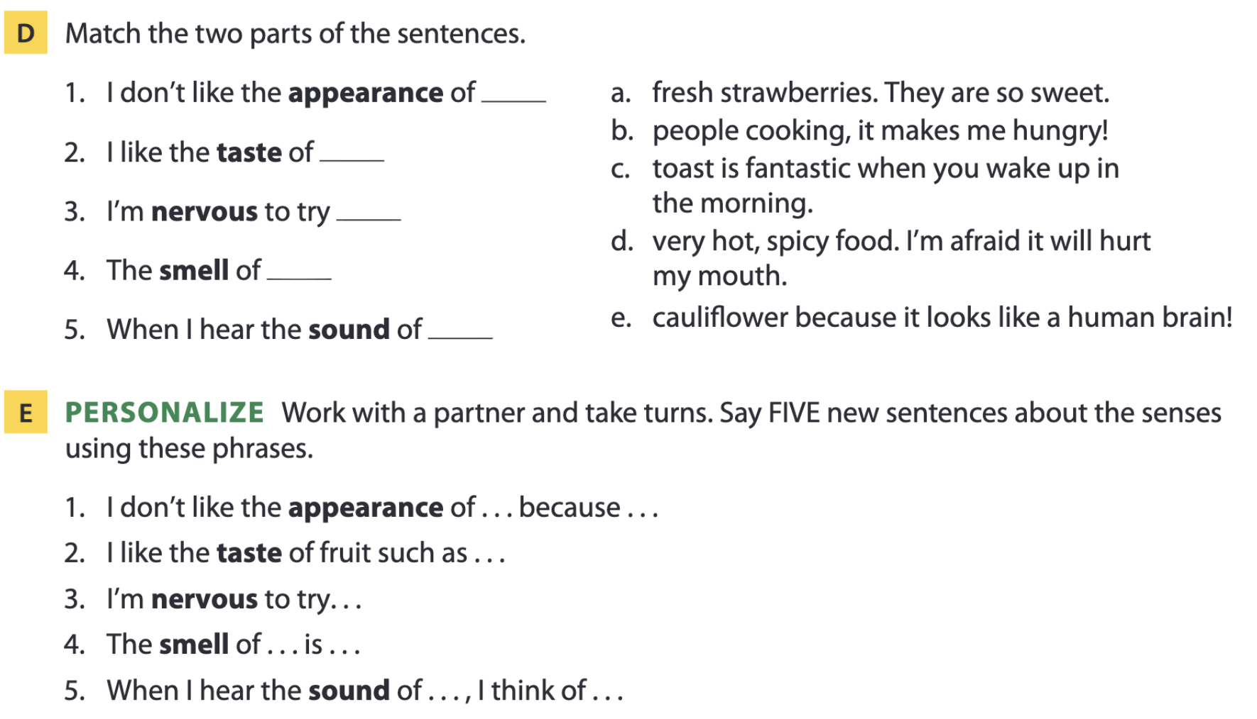
Page 93
e
a
d
c
b

Slide 30
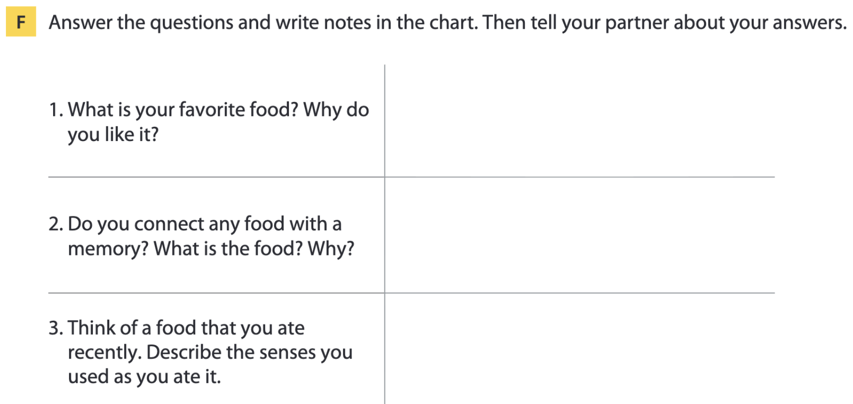
Page 93

Slide 31
05
Listening B

Slide 32
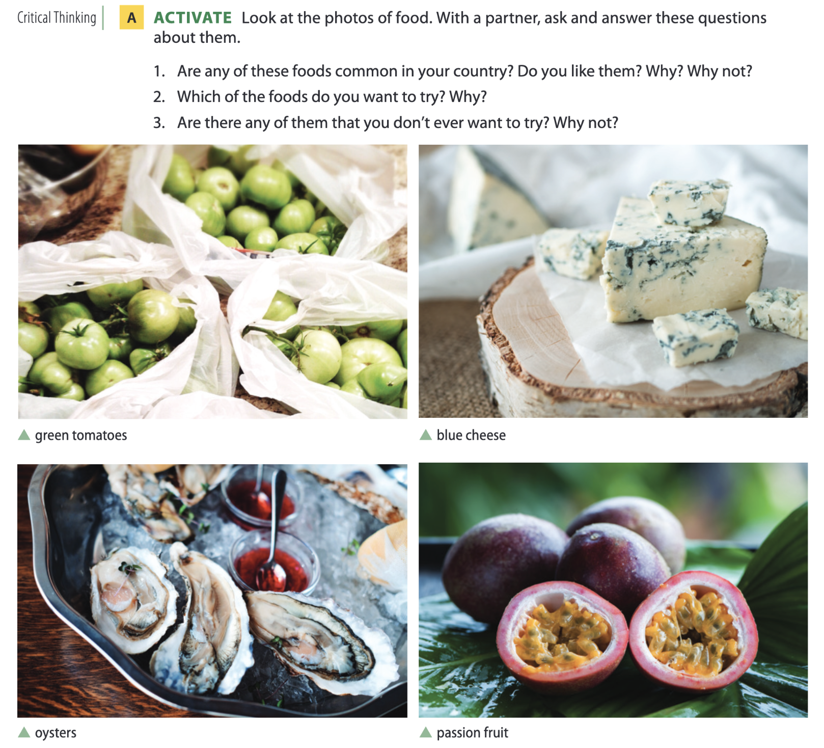
Ugly food
Page 94

Slide 33
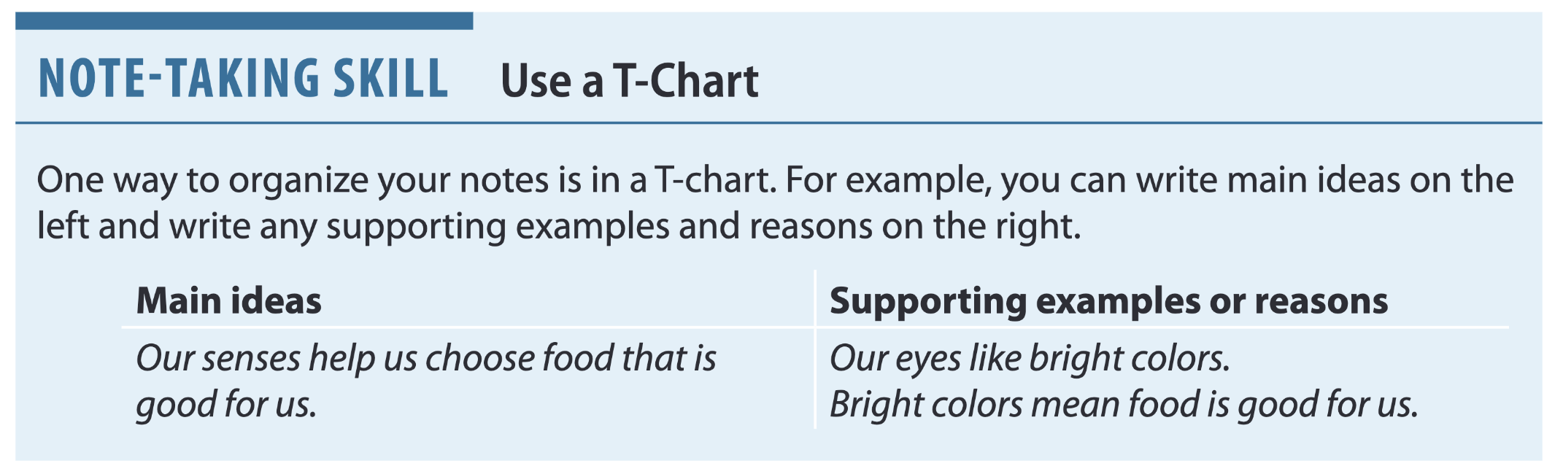
Page 94

Slide 34
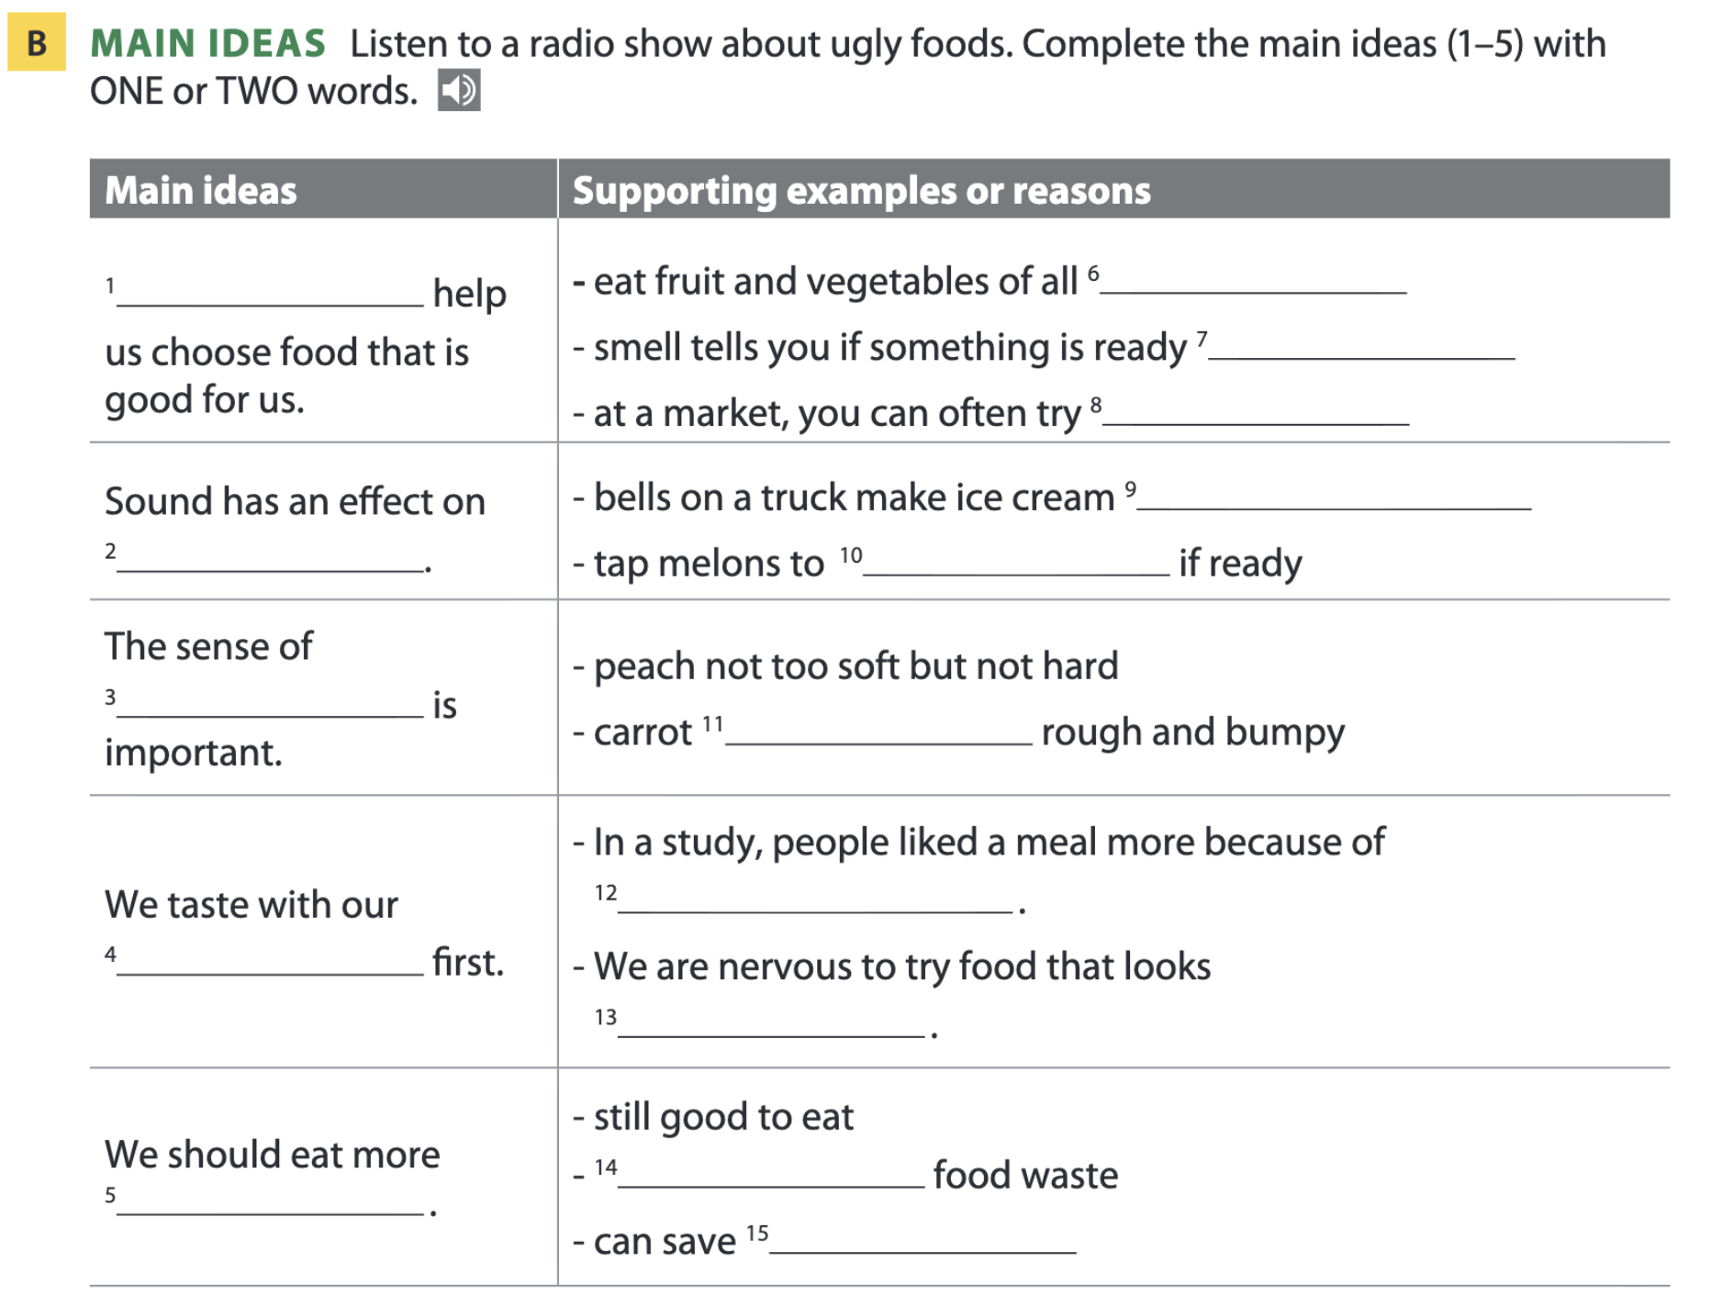
Page 95
senses
flavor
touch
eyes
ugly food

Slide 35
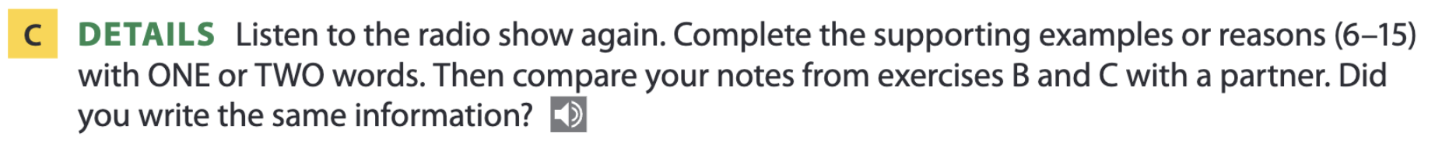
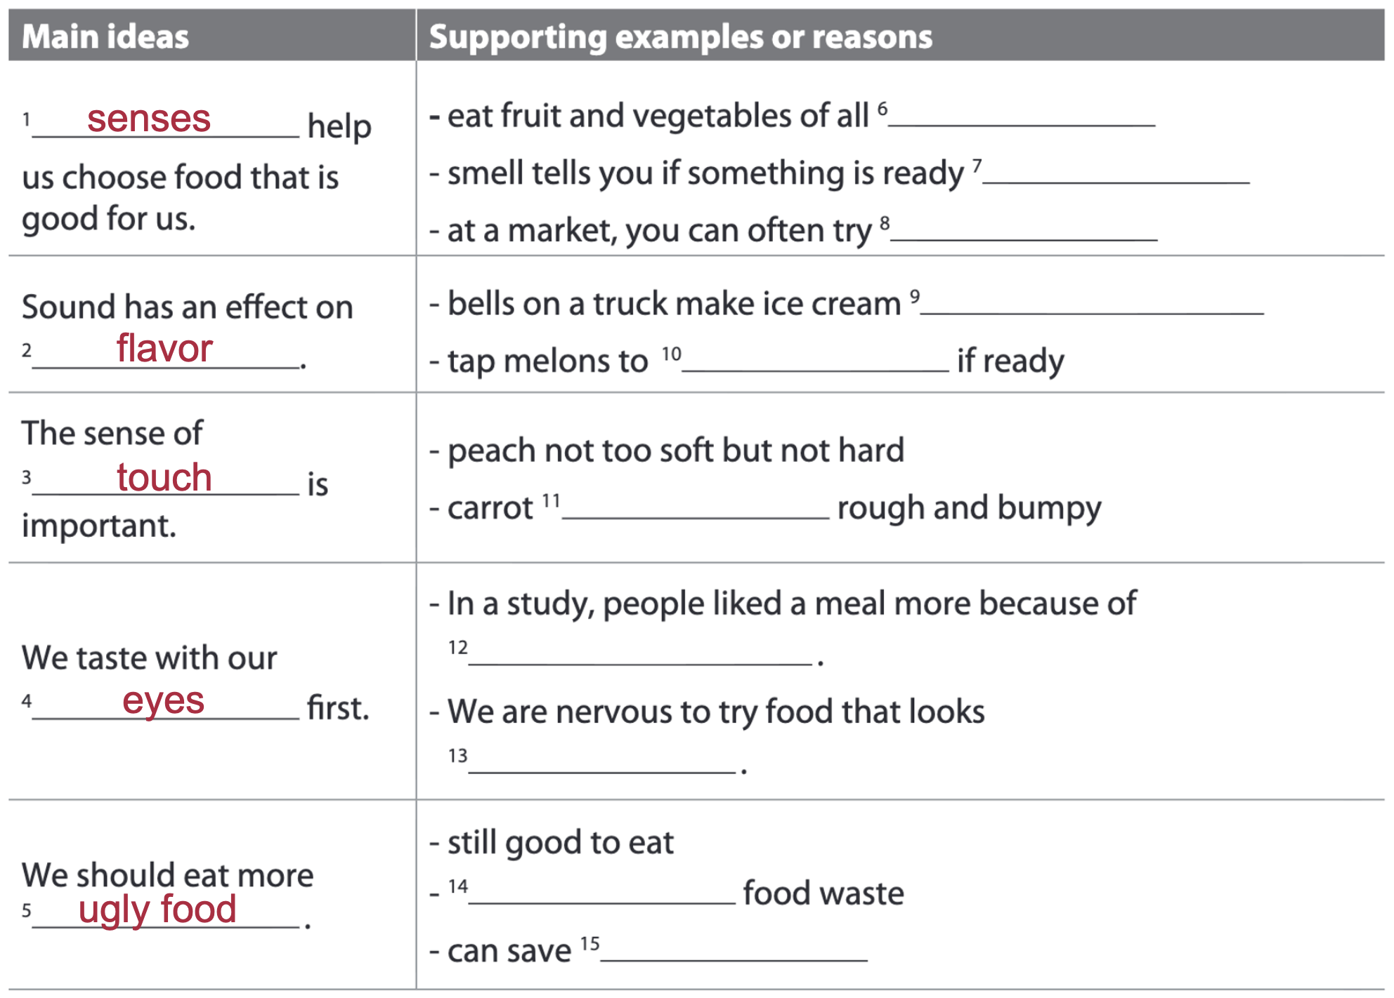
Page 95
colors
to eat
(the) fruit
taste sweeter
hear
feels
its appearance
different
decrease
money

Slide 36
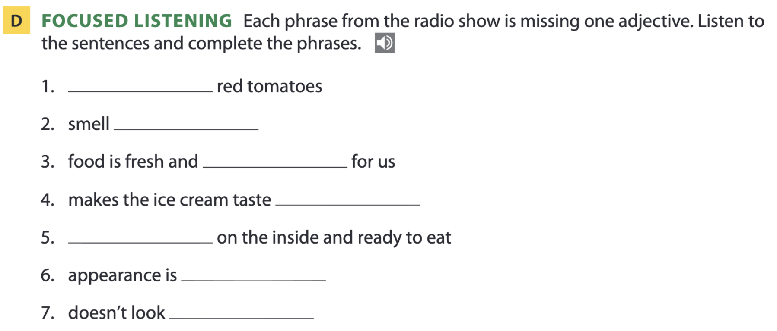
Page 95
colorful
delicious
healthy
sweeter
juicy
strange
perfect

Slide 37
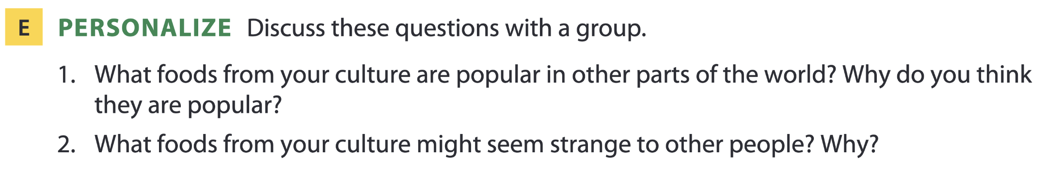
Page 95

Slide 38
THANKS FOR YOUR ATTENTION!

